Slide 1

Title IX Overview for Administrators (Investigatory/Disciplinary Authority)
Atlanta Public Schools

Slide 2
Content Notice
The content and discussion in this training will necessarily engage with sex- and gender-based harassment, discrimination, violence, and associated sensitive topics that can evoke strong emotional responses.
During this training, we may offer examples that emulate the language and vocabulary that Title IX practitioners (you!) may encounter in your roles including slang, profanity, and other graphic or offensive language. It is not used gratuitously, and no offense is intended.

Slide 3

Title IX: A Primer

Slide 4
What is Title IX?
Title IX of the Education Amendments of 1972
Protects people from discrimination based on sex in education programs or activities that receive federal financial assistance.
Enforced by the Office of Civil Rights (“OCR”).
Protects all persons from discrimination, including parents and guardians, students, and employees.
What does Title IX say?
  No person in the United States shall, on the basis of sex, be excluded from participation in, be denied the benefits of, or be subjected to discrimination under any education program or activity receiving Federal financial assistance.

Slide 5

Title IX in Athletics
School districts must provide equal athletic opportunities for both sexes.
OCR considers whether an institution is effectively accommodating the athletic interests and abilities of students of both sexes.
Factors that are considered by OCR:
  Equipment and supplies;
  Game and practice times;
  Travel and per diem allowances;
  Coaching and academic tutoring;
  Assignment and compensation of coaches and tutors;
  Locker rooms, practice and competitive facilities;
  Medical and training facilities and services;
  Housing and dining facilities and services; and
  Publicity.

Slide 6

Doesn’t Title IX Only Apply to Athletics?
NO!
Title IX also applies to:
  Recruitment, admissions and counseling
  Sex based harassment
  Treatment of pregnant and parenting students
  Discipline
  Single sex education
  Employment matters

Slide 7

Other Examples of Title IX Issues
Discrimination in student discipline
Unequal access to educational resources
  STEM opportunities / programs
  Career / technical education

Slide 8

Statutory and Regulatory Changes

Slide 9

Recent Changes to Title IX Regulations
OCR amended Title IX Regulations in 2020, focusing on those provisions pertaining to sexual harassment.
Subsequent 2024 regulatory amendments were subsequently revoked and have never been in effect in Georgia.
This presentation will focus on 2020 (current) Title IX obligations and requirements that are relevant to K12 school districts.

Slide 10
Title IX Policies and Procedures
Atlanta Public Schools has its own comprehensive Title IX policies and procedures.
They are periodically updated to comply with applicable Title IX Regulations, but should be each employee’s starting point with respect to Title IX matters.
The District’s Title IX Coordinator and Title IX staff are valuable resources for school-level administrators as they receive complaints, investigate allegations, and implement supportive measures and/or sanctions.
Make sure you are familiar with Board policies associated with Title IX, discrimination, harassment, grievance procedures – available on District website.

Slide 11

Student-on-Student Sexual Misconduct
According to data from the U.S. Department of Education’s Office for Civil Rights, there were 14,938 incidents of sexual violence in K–12 schools in 2017 – 2018 compared with 9,649 in 2015 – 2016, representing a 55 percent increase.
According to a 2019 report from the National Center for Educational Statistics, the number of reported forcible sex offenses on school campuses increased from 2,200 in 2001 to 10,400 in 2017 (a 372 percent increase).
Both the 2015 – 2016 Civil Rights Data Collection and the Data Highlight on School Climate and Safety published in 2018 indicated that students reported approximately 9,700 incidents of sexual assault, rape, or attempted rape at elementary and secondary schools in the 2015 to 2016 academic year.
Research from Hofstra University found that roughly 1 in 10 students in K-12 schools have suffered “some form of sexual misconduct by an educator,” but student-on-student sexual misconduct continues to be a matter of great concern to the District.

Slide 12

Student-on-Student
Sexual Misconduct: Prevention
Create a culture of consent.
Partner with parents and other trusted adults in students’ lives.
Share age-appropriate resources for education.
Monitor high-risk areas or activities (but know that sexual misconduct or abuse can and does take place in areas that may not be deemed “high risk”).
Dispel common sexual misconduct myths and misconceptions.

Slide 13

Student-on-Student
Sexual Misconduct: Identification
Student-on-student sexual misconduct can take many forms. Misconduct might include, but is not limited to:
  Title IX specific offenses, hostile environment, or quid pro quo;
  Dating or relationship violence;
  Transmitting sexually explicit images, photos, videos or any other media without the consent of the recipient and all involved parties;
  Soliciting or promoting sexual performance using minors;
  Inappropriate touching of private body parts;
  Invasions of privacy;
  Sexual exploitation;
  Other inappropriate behaviors of a sexual nature.
If you see (or hear or otherwise become aware of) something, make a report to the Title IX Office!

Slide 14

Student-on-Student
Sexual Misconduct: Identification
Non-exhaustive behaviors to look out for:
  Ducking behind desks, lab benches, gym mats, or using other methods to avoid detection;
  Shushing or motioning for other students to be quiet so as not to draw attention;
  Removal or alteration of clothing;
  Inappropriate physical contact with others or with oneself;
  Fear of physical contact;
  Emotional manipulation or assertion of pressure;
  Excitement surrounding a cell phone or mobile device;
  Unwelcome touching, pinching, or restraining of students by another student;
  Catcalling or suggestive comments;
  Obscene gestures;
  Refusal to sit next to or near another student;
  Behavioral changes.

Slide 15
Student-on-Student
Sexual Misconduct: Reporting
If you see or hear or are told about something, say something.
ALL allegations of conduct that MIGHT qualify as sex discrimination—in any form—MUST be reported TO THE TITLE IX COORDINATOR as quickly as possible.
APS’s Title IX Coordinator is Felisha Jackson. She can be reached at Felisha.jackson@atlanta.k12.ga.us

Slide 16
Student-on-Student
Sexual Misconduct: Investigation
Must be adequate, reliable, and impartial.
Burden on the assigned Title IX investigator to conduct the investigation and gather evidence.
Equal opportunity to be accompanied by an advisor (which can be, but isn’t required to be, an attorney).
Parties must have equal opportunity to present fact and expert witnesses, inculpatory & exculpatory evidence that is relevant and permissible.
Determine what evidence is relevant and what evidence is impermissible even if it’s relevant.
Provide equal opportunity to access relevant and not otherwise impermissible evidence: investigative report and evidence inspection (10 day timeline).
Take reasonable steps to prevent and address unauthorized disclosure.
Notes:
After you report an incident of observed or suspected sexual misconduct to the Title IX Coordinator, the District will conduct an investigation. You may be asked questions as part of that investigation and should cooperate fully with the District during this process.
Here are the nuts and bolts of the 2024 (and sometimes 2020) Regulations’ requirements for the mechanics of an investigation. The overarching goal is to gather the facts and present them, along with the relevant and permissible evidence, to the Decision-Maker.

Slide 17
Student-on-Student
Sexual Misconduct: Resolution
Standard of Proof: Preponderance of the evidence.
  “More likely than not” that the conduct occurred.
  “50% and a feather”
If the Decision-Maker is not persuaded under that standard by the evidence that sex discrimination occurred, whatever the quantity of the evidence is, the Decision-Maker must not determine that sex discrimination occurred.
Under both the 2020 and 2024 Regs the District is not required to hold a live hearing.
Determination must be issued in writing and must include:
  The rationale for the determination, and
  The procedures and bases for appeal.
Title IX Coordinator must coordinate provision and implementation of remedies and sanctions.
Notes:
After you report an incident of observed or suspected sexual misconduct to the Title IX Coordinator, the District will conduct an investigation. You may be asked questions as part of that investigation and should cooperate fully with the District during this process.
Here are the nuts and bolts of the 2024 (and sometimes 2020) Regulations’ requirements for the mechanics of an investigation. The overarching goal is to gather the facts and present them, along with the relevant and permissible evidence, to the Decision-Maker.

Slide 18
Students With Disabilities: Additional Considerations
Students with disabilities may be at an increased risk of experiencing sex discrimination or sex-based harassment, due in part to:
Communication barriers that prevent giving consent and disclosing abuse;
Potential decreased capacity to consent to sexual activity;
Limited sexual education and knowledge;
Increased personal care needs requiring close contact.
Students traveling on Special Education busses or in in Special Education classrooms are not inherently or automatically safer than those students on General Education busses or in General Education classrooms.
Notes:
This list of risk factors is not exhaustive, but evidence does suggest that children with intellectual and/or developmental disabilities are at a higher risk for sexual abuse and victimization than their non-disabled peers.

Slide 19
Consent Considerations
The Assistant Secretary [OCR] will not require recipients [schools] to adopt a particular definition of consent with respect to sexual assault, as referenced in this section [the 2020 Title IX Regulations].
Educating students about consent:
  For students:
    Consent means that you agree to something. You say YES. But consent isn’t just saying YES.
    We need our consent to be “informed.” Informed consent means that when you say YES, you understand exactly what you are agreeing to and what the results may be.
    Your body belongs to you, and someone needs to ask to get consent from you before touching you. Remember, “My body belongs to me.”
    You can say NO to someone touching you, or say YES to one thing (hugging) and NO to another (kissing).
    You must also get consent from other people before you touch them. The other person must say YES.

Slide 20
Consent Considerations and Intersection with Students with Disabilities
When considering whether or not a student consented, their special education status/disability needs to be considered.
Non-verbal students may have trouble giving or communicating consent.
Students with severe intellectual disabilities cannot provide informed consent to sexual activity.
Consent cannot and should not be assumed, particularly in the case of students with disabilities. Not all disabilities are visible, and cognitive disabilities may prevent students who physically or developmentally resemble their peers from fully understanding their conduct or its consequences.

Slide 21
Title IX Life Cycle
1. Receipt of Complaint
2. Report to Title IX Coordinator
3. Intake & Evaluation
4. Investigation
5. Determination Regarding Responsibility
6. Appeal
Notes:
This is just an overview slide, and it’s pretty simplified for ease of reference. We wanted to give you an idea of how the pieces fit together. Forests and trees and whatnot.
You should be generally familiar with this process and with how your roles fit into it.

Slide 22
Sexual Harassment
If a school district has actual knowledge of sexual harassment in an education program or activity of the school district against a person in the United States, it must respond promptly in a manner that is not deliberately indifferent.

Slide 23
“Actual Knowledge”
“Actual knowledge” means notice of sexual harassment or allegations of sexual harassment to a recipient’s Title IX Coordinator or any official of the recipient who has authority to institute corrective measures on behalf of the recipient or to any employee of an elementary and secondary school.
  Administrators
  Teaching staff
  Clerical staff
  Custodial and food service staff
  Transportation staff
  YOU!!

Slide 24

“Education Program or Activity of School District”
What is “an education program or activity of the school district”?
  Any location, event, or circumstance over which the school district exhibits substantial control over both the alleged harasser and the context in which the harassment occurred.
Title IX does not impose a duty to report purely off-campus conduct.

Slide 25

“Education Program or Activity of School District”
Conduct occurring in a building owned or controlled by a student organization that is officially recognized by the District constitutes an “activity of the school district.”
If conduct occurs on an international field trip or at any location outside the United States, it is excluded from this definition.
What about sexual misconduct that occurred off-campus but has an on-campus effect?
  This falls outside the DOE’s jurisdictional requirements and would be addressed through other District policies.

Slide 26
“Deliberate Indifference”
A school district is “deliberately indifferent” if its response to sexual harassment is clearly unreasonable in light of the known circumstances.

Slide 27
Three Categories of Sexual Harassment
There are three categories that meet OCR’s definition of sexual harassment and must be reported
  Quid pro quo
  Sexual assault, dating violence, domestic violence, stalking
  “Unwelcome conduct determined by a reasonable person to be so severe, pervasive, and objectively offensive that it effectively denies a person equal access to the recipient’s education program or activity”
Remember, though, that ALL incidents of sexual misconduct—even misconduct that doesn’t fall into the above categories—should be reported promptly to your supervisor and to the Title IX office for review.

Slide 28
Sexual Harassment: Category 1
“Quid pro quo”
If an employee of the school district conditions the provision of an aid, benefit, or service of the school district on an individual’s participation in unwelcome sexual conduct, this is sexual harassment.
This conduct must be reported.

Slide 29
Sexual Harassment: Category 2
“Sexual assault” as defined in 20 U.S.C. § 1092(f)(6)(A)(v)
“Dating violence” as defined in 34 U.S.C. § 12291(a)(10)
“Domestic violence” as defined in 34 U.S.C. § 12291(a)(8)
“Stalking” as defined in 34 U.S.C. § 12291(a)(30)
Conduct that falls within any of these definitions must be reported.

Slide 30
Sexual Harassment: Category 3
“Unwelcome conduct determined by a reasonable person to be so severe, pervasive, and objectively offensive that it effectively denies a person equal access to the recipient’s education program or activity.”
This conduct must be reported.

Slide 31
What Happens After Report of
Sexual Harassment
Upon a report or formal complaint of sexual harassment, a school district must treat complainants and respondents equitably by offering supportive measures to both and following a grievance process before disciplining/sanctioning respondents.
  Complainant means an individual who is alleged to be the victim of conduct that could constitute sexual harassment.
  Respondent means a person who has been reported to be a perpetrator of conduct that could constitute sexual harassment.

Slide 32
“Supportive Measures”
Non-disciplinary, non-punitive individualized services offered as appropriate, as reasonably available, and without fee or charge to the complainant or the respondent before or after the filing of a formal complaint or where no formal complaint has been filed.
Designed to restore or preserve equal access to the school district’s education program or activity, without unreasonably burdening the other party, including measures designed to protect the safety of all parties or the school district’s educational environment, or deter sexual harassment.
Cannot be punitive.

Slide 33

Examples of
Supportive Measures
Counseling
Extensions of deadlines or other course-related adjustments
Modifications of work or class schedules
Campus escort services
Mutual restrictions on contact between the parties
Changes in work or housing locations
Leaves of absence
Increased security and monitoring of certain areas of the campus
Special supports for special education students
Other similar measures

Slide 34
Supportive Measures
Title IX Coordinator must promptly contact complainant to:
  Discuss the availability of supportive measures
  Consider the complainant’s wishes with respect to supportive measures
  Inform the complainant of the availability of supportive measures with or without the filing of a formal complaint
  Explain to the complainant the process for filing a formal complaint

Slide 35
Grievance Process
A school district’s response must treat complainants and respondents equitably by following a grievance process before the imposition of any disciplinary sanctions or other actions that are not supportive measures against a respondent.

Slide 36
Grievance Process Continued
Emergency removal of a respondent from an educational program or activity is permitted on an emergency basis IF the school district:
  Undertakes an individualized safety and risk analysis,
  Determines that an immediate threat to the physical health or safety of any student or other individual arising from the allegations of sexual harassment justifies removal, and
  Provides the respondent with notice and an opportunity to challenge the decision immediately following the removal.
Emergency removal is subject to the student’s rights under the IDEA, Section 504 of the Rehabilitation Act of 1973, and the Americans with Disabilities Act.
Title IX Coordinators or their designees are the only individuals who can enact an emergency removal!

Slide 37

Grievance Process Continued
School districts may place non-student employee-respondents on administrative leave during the pendency of a formal grievance process subject to the employee’s rights under Section 504 and the ADA.

Slide 38
Grievance Process: Retaliation Prohibited
Cannot retaliate against a person for purpose of interfering with any right under Title IX or because that person has been involved in a Title IX investigation, proceeding or hearing.
What constitutes “retaliation”?
  Intimidation, threats, coercion, or discrimination that arises out of the same facts/circumstances as report or complaint of sex discrimination or report/complaint of sexual harassment.

Slide 39

Grievance Process: Retaliation Prohibited
First Amendment
  The exercise of rights protected under the First Amendment does not constitute retaliation.
  Parties can speak about their experiences.
Materially False Statements
  Charging an individual with a code of conduct violation for making a materially false statement in bad faith in the course of a grievance proceeding does not constitute retaliation IF the determination regarding responsibility, alone, is not sufficient to conclude that any party made a materially false statement in bad faith.

Slide 40
Grievance Process:
Other Considerations
A school district’s treatment of a complainant or a respondent in response to a formal complaint of sexual harassment may itself constitute sex discrimination under Title IX.
Grievance process must treat complainants and respondents equitably:
  Provide remedies to a complainant where a determination of responsibility for sexual harassment has been made against the respondent; and
  Follow a grievance process before the imposition of any disciplinary sanctions or other actions that are not supportive measures against a respondent.

Slide 41
Grievance Process: Basic Requirements
Require an objective evaluation of all relevant evidence.
Provide that credibility determinations may not be based on a person’s status as a complainant, respondent, or witness.
The Title IX Coordinator, investigator, decision-maker, or any person facilitating the informal resolution process may not have a conflict of interest or bias and must receive adequate training.
Training materials cannot rely on sex stereotypes and must promote impartial investigations / adjudications.

Slide 42
Grievance Process:
Basic Requirements Continued
The respondent is presumed not responsible until a determination regarding responsibility is made at the conclusion of the grievance process.
Prompt timeframes for conclusion of the entire grievance process, including informal resolution process and appeals are required.
Must allow temporary delay of the grievance process or the limited extension of time frames for good cause with written notice to the parties.
  “Good cause” includes the absence of a party, party’s advisor or witness; concurrent law enforcement activity; and the need for language assistance or accommodation of disabilities.

Slide 43
Grievance Process:
Basic Requirements Continued
A school district’s grievance process:
  Must describe range of potentially available disciplinary sanctions and remedies;
  Must specify the standard of evidence that will be used and apply that standard to all complaints:
    Preponderance of the evidence;
    Clear and convincing evidence;
  Must include procedures and permissible bases for parties to appeal;
  Must describe the range of supportive measures available to the parties;
  May not allow any evidence or questions that would invade a legally recognized privilege, unless the privilege holder waives it.

Slide 44

Grievance Process:
Notice of Allegations
Upon receipt of a formal complaint, a school district must provide known parties with written notice of various matters, including:
  The formal complaint’s allegations;
  The formal grievance procedures; and
  Any code-of-conduct provision that prohibits knowingly making false statements or submitting false information during the grievance process.

Slide 45
Grievance Process: Dismissal
Mandatory Dismissal
  Dismissal is required if the alleged conduct does not meet “basic jurisdictional requirements” under Title IX.
Permissive dismissal
  A formal complaint or any allegation within the complaint CAN be dismissed at any time during the investigation or hearing IF:
    The complainant notifies Title IX Coordinator in writing that he/she would like to withdraw the formal complaint or any allegations therein;
    The respondent is no longer enrolled in or employed by school district; or
    Specific circumstances prevent the school district from gathering evidence sufficient to reach a determination as to the formal complaint or the allegations therein.
Upon dismissal, the school district must provide prompt written notice to the parties.

Slide 46
Grievance Process: Investigation
The school district is tasked with gathering evidence sufficient to reach a determination.
The parties must receive an equal opportunity to present witnesses and any inculpatory and exculpatory evidence.
There can be no restriction on the parties’ ability to discuss the case and gather evidence.
The parties must have opportunity to have others present during a grievance proceeding, including an advisor of their choice (can be an attorney).
  *But the school district can restrict the extent to which advisors may participate IF the restrictions apply equally to both parties.

Slide 47
Grievance Process: Investigation
Must provide to the party whose participation is invited or expected written notice of the date, time, location, participants, and purpose of all hearings, investigative interviews, or other meetings with a party, with sufficient time for the party to prepare to participate.
Both parties must receive an equal opportunity to inspect/review any evidence.
  Before an investigative report is completed, both parties (and their advisors) must receive the evidence and have ten days to submit a written response.
  The investigator must consider the written response before completing the final report.

Slide 48

Grievance Process: Investigation
Must create an investigative report that fairly summarizes the relevant evidence and provide the parties (and their advisors) with a copy at least ten days before a hearing “for their review and written response.”
A live hearing is NOT required for K12 school districts.

Slide 49
Grievance Process: Adjudication
After providing investigative report to both parties, each party must have opportunity to submit written questions that a party wants asked of any party or witness.
Live hearings with cross-examination are not required in the K-12 setting.
Each party must also receive the answers to the questions and must be allowed to submit additional, limited follow up questions.
The decision maker must issue a written determination regarding responsibility which includes:
  Allegations constituting sexual harassment;
  Description of the matter’s procedural history;
  Findings of fact supporting the determination;
  Conclusions reached by applying the school’s code of conduct to the facts;
  Explanation of the rationale for the conclusions, including a determination of responsibility, disciplinary sanctions, and remedies; and
  Description of the school’s appellate procedures.

Slide 50

Grievance Process:
Determination of Responsibility
The school district must provide the written documentation to the parties simultaneously.
The determination regarding responsibility becomes final either on:
  The date that the school district provides the parties with the written determination of the result of the appeal (if appeal is filed); OR
  The date on which an appeal would no longer be considered timely (if no appeal is filed).

Slide 51
Grievance Process:
Determination of Responsibility
Title IX Coordinator is responsible for effective implementation of any remedies.
Both parties must have opportunity to appeal the following:
  Determination regarding responsibility (on limited grounds); and
  Dismissal of a formal complaint or any allegation therein.

Slide 52
Grievance Process: Appeals
Mandatory grounds for appeal:
  Procedural irregularity that affected the outcome of the matter;
  New evidence that was not reasonably available at the time the determination regarding responsibility or dismissal was made, that could affect the outcome of the matter; and
  The Title IX Coordinator, investigator(s), or decision-maker(s) had a conflict of interest or bias that affected the outcome of the matter.
School districts can offer appeals equally to both parties on additional bases.
  Please see Title IX Grievance Procedure for more information about bases for appeal.

Slide 53
Grievance Process: Informal Resolution
A school district may facilitate an informal resolution process, such as mediation, in lieu of a formal grievance process.
Must first provide written notice to the parties of their rights, including the right to withdraw from the process at any time, and obtain both parties’ voluntary, written consent to informal measures.
Informal resolution processes are not allowed for formal complaints involved employee-respondents.

Slide 54
Grievance Process:
Record Keeping Requirements
School districts must maintain the following records for 7 years:
  Each sexual harassment investigation, including determination, sanctions, and remedies resulting therefrom;
  Any appeals therefrom;
  Any informal resolutions thereof; and
  All training materials, which the recipient must also make available for public inspection.
School districts must also maintain records of any other actions it takes, including supportive measures, in response to reports or formal complaints of sexual harassment.
This is why understanding the entirety of the process is so important—your actions (the District’s actions) will be memorialized for years, and it’s important to get it right.

Slide 55
Reporting
ALL employees are responsible for reporting sexual harassment AND allegations of sexual harassment.
Reports should be made IMMEDIATELY.
Staff can report sexual harassment to their principal, who can assist in ensuring this conduct is reported properly.
The District’s Title IX Coordinator and Title IX staff are valuable resources for school-level administrators as they receive complaints, investigate allegations, and make determinations regarding responsibility.
APS’s Title IX Coordinator is Felisha Jackson. She can be reached at Felisha.jackson@atlanta.k12.ga.us

Slide 56
Relevant Definitions
Complainant means an individual who is alleged to be the victim of conduct that could constitute sexual harassment. At the time of filing a formal complaint, a Complainant must be participating in or attempting to participate in an APS “education program or activity.”
Respondent means an individual who has been reported to be the perpetrator of conduct that could constitute sexual harassment.
Sexual Harassment means conduct on the basis of sex that satisfies one or more of the following:
  (1) An employee of the recipient conditioning the provision of an aid, benefit, or service of the recipient on an individual's participation in unwelcome sexual conduct (“quid pro quo harassment”);
  (2) Unwelcome conduct determined by a reasonable person to be so severe, pervasive, and objectively offensive that it effectively denies a person equal access to the recipient's education program or activity (“hostile environment harassment”); or
  (3) “Sexual assault” as defined in 20 U.S.C. 1092(f)(6)(A)(v), “dating violence” as defined in 34 U.S.C. 12291(a)(10), “domestic violence” as defined in 34 U.S.C. 12291(a)(8), or “stalking” as defined in 34 U.S.C. 12291(a)(30).

Slide 57
Title IX Jurisdiction: The 2020 Title IX Regulations apply only to conduct that occurs in the United States. Specifically, for the 2020 Title IX Regulations to apply, the alleged conduct must have occurred within the context of an APS “education program or activity,” which includes locations, events, or circumstances over which the District exercises substantial control over both the Respondent and the context in which the sexual harassment occurs. This includes, but is not limited to:
  On-campus conduct;
  Field trips;
  Home and away athletics events; and
  School-sponsored extracurricular activities.

Slide 58
Relevant Evidence is evidence that tends to prove or disprove a fact in question. Relevant evidence can be exculpatory (offered in support of someone’s innocence or responsibility) or inculpatory (points to someone’s guilt or responsibility). Some evidence, even if it’s relevant, should be excluded from an Investigative Report:
  Treatment records: APS cannot access, consider, disclose, or otherwise use a party's records that are made or maintained by a physician, psychiatrist, psychologist, or other recognized professional or paraprofessional acting in the professional's or paraprofessional's capacity, or assisting in that capacity, and which are made and maintained in connection with the provision of treatment to the party, unless the recipient obtains that party's voluntary, written consent.
  Privileged information: APS must not require, allow, rely upon, or otherwise use questions or evidence that constitute, or seek disclosure of, information protected under a legally recognized privilege, unless the person holding such privilege has waived the privilege.
  Complainant’s sexual history: Questions and evidence about the Complainant's sexual predisposition or prior sexual behavior are not relevant, unless
    (1) Such questions and evidence about the Complainant's prior sexual behavior are offered to prove that someone other than the Respondent committed the conduct alleged by the complainant, or
    (2) If the questions and evidence concern specific incidents of the complainant's prior sexual behavior with respect to the respondent and are offered to prove consent.

Slide 59
Title IX Requirements and Protections
Individuals involved in Title IX matters have rights which must be respected throughout the Title IX process. Those rights and protections include, but are not limited to:
  The requirement that APS follow a prescribed Title IX grievance process before imposing any disciplinary sanctions or other actions that are not supportive measures against a Respondent;
  An understanding that credibility determinations may not be based on a person's status as a Complainant, Respondent, or witness;
  Prohibitions on Investigators and other Title IX staff having any conflict of interest or bias for or against Complainants or Respondents generally or an individual Complainant or Respondent;
  A presumption that the Respondent is not responsible for the alleged conduct until a determination regarding responsibility is made at the conclusion of the grievance process;
  Protections against the inclusion of irrelevant or impermissible evidence;
  The right of parties to have an advisor of their choice, who may or may not be an attorney, present during the Title IX process (including at your investigative interviews);
  An assurance that the burden of gathering sufficient evidence regarding responsibility rests on the District and not on the parties;

Slide 60
An equal opportunity for the parties to present witnesses, including fact and expert witnesses, and other inculpatory and exculpatory evidence;
No restrictions on the ability of either party to discuss the allegations under investigation or to gather and present relevant evidence;
Written notice of the date, time, location, participants, and purpose of all hearings, investigative interviews, or other meetings, with sufficient time for the party to prepare to participate;
An equal opportunity for the parties to inspect and review evidence directly related to the allegations;
A 10-day window in which to submit a written response to the draft Investigative Report, and the requirement that investigators consider any written feedback prior to finalizing the Investigative Report; and
An equal opportunity for the parties to submit written, relevant questions that a party wants asked of any party or witness, an obligation to provide each party with the answers, and the requirement to allow for additional, limited follow-up questions from each party before an ultimate decision regarding responsibility is made.

Slide 61
Investigatory Approach
When conducting Title IX investigations, remember that these matters are sensitive, highly emotional, and may have significant implications on individuals’ educational access and outcomes. Sexual harassment has tangible and long-lasting impacts on those who experience it, and allegations of misconduct (even if ultimately disproven) are stigmatizing and potentially limiting to those who are accused. To that end, investigations should be confidential, sensitive, and professional.
Some of the most important qualities of a competent, skilled investigator include:
Preparation: Before interviewing anyone associated with a Title IX matter, review the formal complaint and any available evidence. You should NOT pre-judge the evidence, pre-assign weight to an individual’s answers, or develop an internal narrative of what you “think” happened. Use the existing file to inform your questions, but don’t let it dictate them.
Flexibility: Research and evidence on the effects of trauma tell us that parties’ recollections of events is often not linear or chronological; skilled investigators are able to pick up and put down conversation threads as the person they are interviewing changes direction. The ability to connect the dots in real time, even if the person you are interviewing appears to tell a fractured narrative, allows for a cohesive delivery of information in an Investigative Report.

Slide 62
Emotional Intelligence: Title IX cases are emotional, stressful, and often frightening for those involved. Parties may be concerned about sanctions like suspension or expulsion, retaliation, potential impacts to college admissions or extracurricular participation, and other tangible and intangible consequences of alleging or being accused of any form of sexual harassment. Interviewers should attempt to build rapport and establish trust with Title IX parties, while acknowledging that repeated interviews may re-traumatize Title IX parties. Understand that “I don’t know” or “I don’t remember” is an acceptable response.
Respect: Interviewers should be respectful of interviewee’s time and experiences. Cell phone ringers and alarms should be turned off or silenced during interviews, and adequate time should be allotted to speak with Complainants, Respondents, and witnesses. Interviewers should be mindful of their body language and other non-verbal cues.

Slide 63
Attention to Detail: Title IX interviewers, in familiarizing themselves with the facts of the case they have been appointed to investigate, should develop party and witness outlines to help guide discussions. If parties give partial answers to your questions, follow up. If parties dodge or don’t answer your questions, rephrase them to ensure the interviewee understands what you are asking of them. If information appears contradictory, seek clarification. Interviewers will need to tailor those outlines in real time depending on the interviewee’s answers, and will need to take detailed notes to determine which items need follow-up.
Neutrality: Interviewers may not appear to have any bias for or against complainants or respondents, and all parties should be treated with dignity and respect. The 2020 Title IX Regulations explicitly state that credibility determinations may not be based on an individual’s status as a Complainant, a Respondent, or a witness, meaning that investigators cannot proceed under an assumption or belief that, for example, all Complainants must be telling the truth or that every Respondent has something to hide. Similarly, the 2020 Regulations prohibit attitudes like “believe women” or “not all men.” Rather, each interview should be neutral, fact-oriented, and objective, aimed at gathering information.

Slide 64
Investigation Mechanics & Techniques
As investigators, it is your job to objectively collect and evaluate all evidence and prepare a comprehensive Investigative Report summarizing the relevant evidence. This collection and evaluation is often accomplished through interviewing people who were involved and by analyzing various forms of evidence (photos, videos, physical evidence, etc.).
1. Introductions: At the beginning of each interview, introduce yourself and explain the investigative interview process.
2. Questioning: Begin with broad, general questions. Once you have the lay of the land, narrow your questions to ask about specific details.
3. Conclusion: At the end of each interview, thank the interviewee for their time. Reiterate your contact information and remind the interviewee to reach out to you if they remember something after the interview.

Slide 65
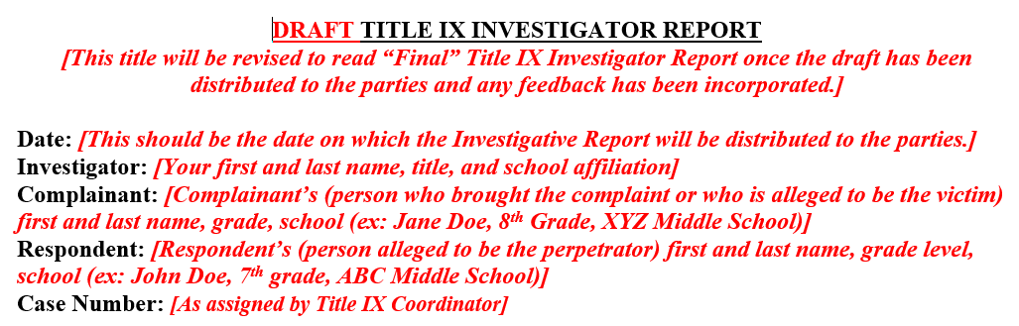

Slide 66
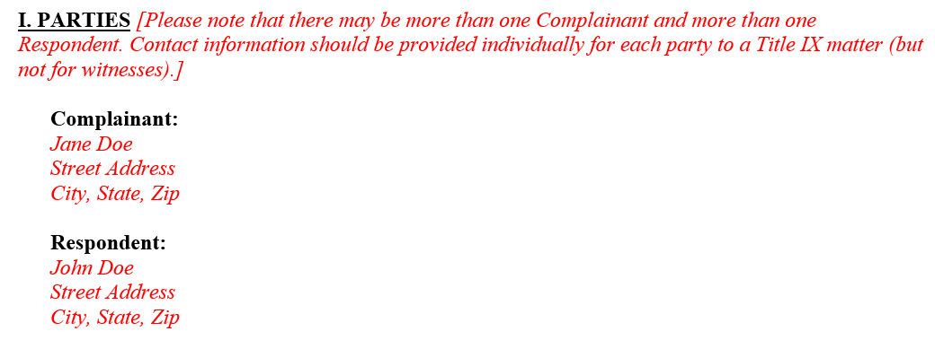

Slide 67
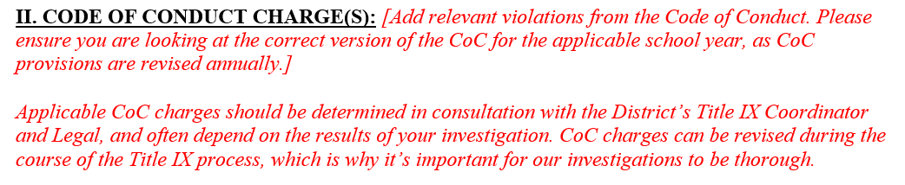

Slide 68
Common Code of Conduct Violations
4B Cyberbullying: Bullying applies to acts which occur on school property or through school technology resources, and also applies to acts which occur through the use of electronic communication, whether or not that communication originated on school property or with school technology resources, if the electronic communication: (1) is directed specifically at students or school personnel, (2) is maliciously intended for the purpose of threatening the safety of those specified or substantially disrupting the orderly operation of the school, and (3) creates a reasonable fear of harm to the students’ or school personnel’s person or property or has a high likelihood of succeeding in that purpose. Electronic communication includes any transfer of signs, signals, writings, images, sounds, data or intelligence of any nature transmitted in whole or in part by a wire, radio, electromagnetic, photo electronic or photo optical system.
4E Offensive Material: No student shall possess, share, or distribute profane, vulgar, pornographic, obscene, threatening or ethnically offensive materials in any format. This includes materials that advocate illegal or dangerous acts, may cause disruption to the Atlanta Public Schools, contains knowingly false or defamatory information, or is otherwise harmful to minors as defined by the Children’s Internet Protection Act. Behaviors that implicate Title IX regulations (as implemented) will be managed as discussed in www.atlantapublicschools.us/titleix Materials deemed to be in violation of the Children’s Internet Protection Act must be reported to school police.
4F Stalking: Following, contacting, or placing another person under surveillance without consent for the purpose of harassing and intimidating, which includes behavior that would cause a reasonable person to: (a) fear for their safety or the safety of others; or (b) suffer substantial emotional distress. Behaviors that implicate Title IX, as implemented, may be addressed through the District’s Title IX Grievance Policy found at: www.atlantapublicschools.us/titleix

Slide 69
Common Code of Conduct Violations
13A Indecent Exposure (Self-Others): No student shall expose their intimate body parts in public or expose the undergarments/ intimate body parts of others. Intimate body parts include the primary genital area, anus, groin, inner thighs, or buttocks of a male or female and the breasts of a female. Behaviors that implicate Title IX regulations (as implemented) will be managed as discussed in www.atlantapublicschools.us/titleix
13B Sexual Activity: No student shall consent to and participate in any form of sexual activity with another student. Behaviors that implicate Title IX regulations (as implemented) will be managed as discussed in www.atlantapublicschools.us/titleix.
13C Sexual Battery: Oral, anal, or vaginal penetration against the person’s will or where the victim did not or is incapable of giving consent; touching of private body parts of another person either through human contact or using an object forcibly or against the person’s will or where the victim did not or is incapable of giving consent. Behaviors that implicate Title IX regulations (as implemented) will be managed as discussed in www.atlantapublicschools.us/titleix

Slide 70
13D Sexual Harassment/Hostile Environment: Unwelcome sexual advances, lewd gestures or verbal conduct, or communications of a sexual nature; requests for sexual favors; gender-based harassment that creates an intimidating, hostile, or offensive educational or work environment. Behaviors that implicate Title IX regulations (as implemented) will be managed as discussed in http://www.atlantapublicschools.us www.atlantapublicschools.us/ titleix
13E Sexual Misconduct/Invasion of Privacy: No student shall commit any act of verbal, written, gesture-oriented, physical sexual misconduct, or invasion of privacy. Invasion of privacy may include the following: Intentionally entering an occupied restroom stall, peeking into a stall or urinal, peeking into showers or changing area, or any other behavior which attempts to invade the privacy of others, whether for sexual gratification or as a joke/prank. Behaviors that implicate Title IX regulations (as implemented) will be managed as discussed in www.atlantapublicschools.us/titleix
13F Sexual Molestation: Sexual molestation is defined as a student doing any immoral or indecent act to or in the presence of another person, without that person’s consent, with the intent to arouse or satisfy the sexual desires of either the student or the other person. This includes a student forcing another person to make physical contact with the student’s intimate body parts, as defined in this Section. No student shall commit any act of sexual molestation or the attempts thereof on school property, school buses, or at school-sponsored events. Behaviors that implicate Title IX regulations (as implemented) will be managed as discussed in www.atlantapublicschools.us/titleix

Slide 71
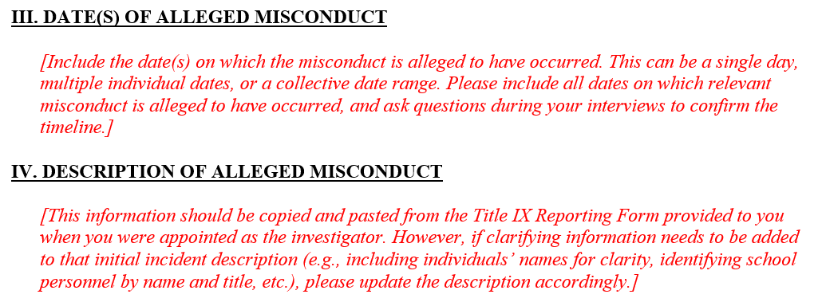

Slide 72
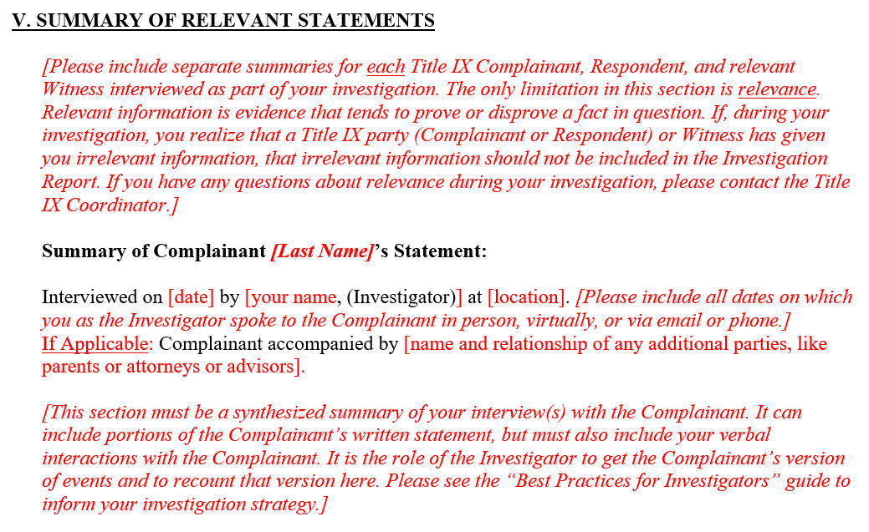

Slide 73
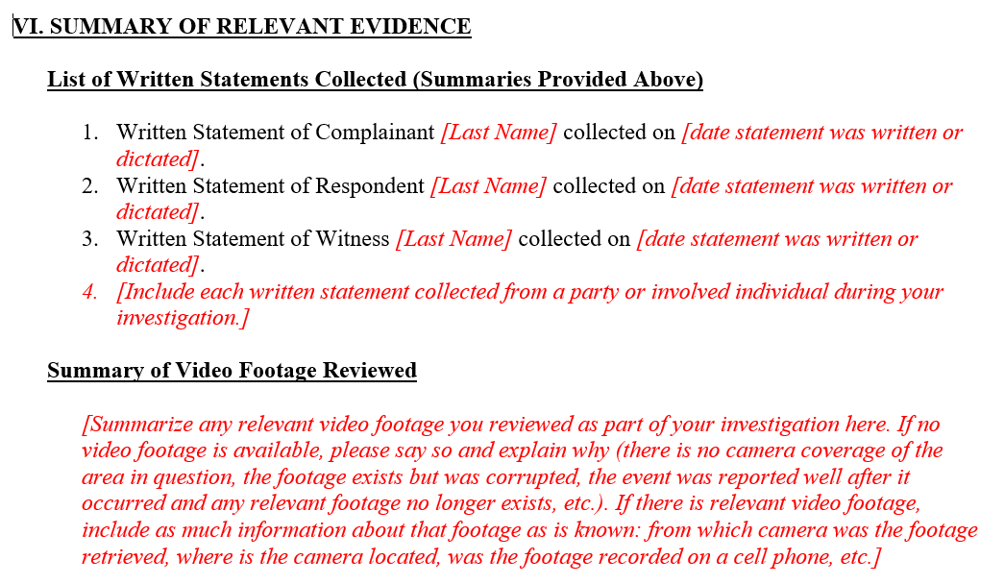

Slide 74
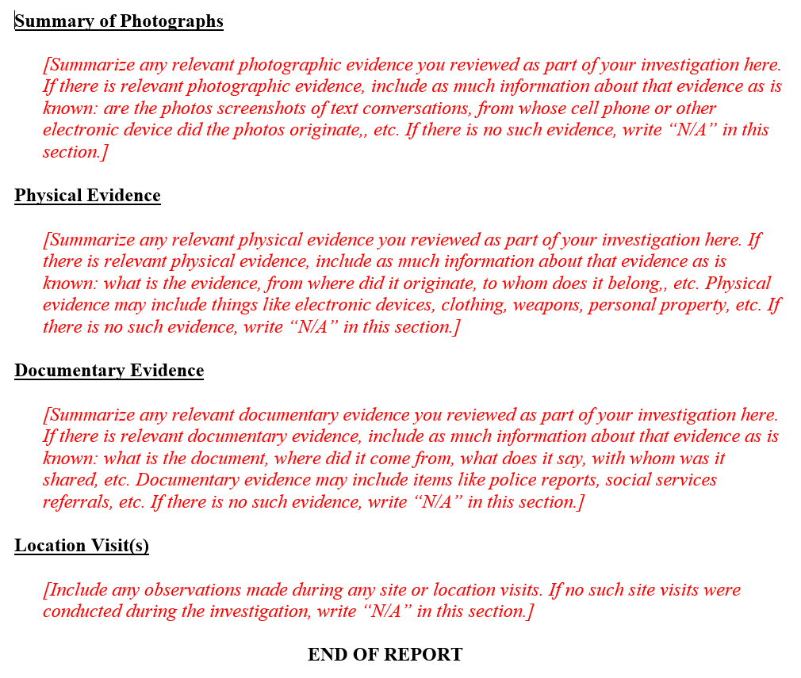

Slide 75
Questions?

